Slide 1
SPACEX
Investment Thesis
$15M Pre-IPO Position Evaluation
Singapore Multi-Family Office | $1.2B AUM
$1.75T
$16B
51%
6M+
IPO Valuation
2025 Revenue (est.)
Global Launch Share
Starlink Subscribers
Prepared by Kepler-C | April 2026
Notes:
Van

Slide 2






Kepler-C Team Introduction
Six teammates · 11 slides · full committee presentation
Aarush Kothapalli
Slide 5
Keean Kawai
Slides 2,3
Strategic Moat Evaluation
Business Overview & Total Market
Moat scorecard, competitor benchmarking, wide-moat conclusion
Business Overview Walkthrough, Revenue Streams, Market Segments
Nancy Zheng
Slides 4,11
Rachel Qiu
Slides 8–9
Competitive Landscape & Investment
Risk Analysis
Competitor benchmarking, entry discipline, $15M structure proposal
Risk matrix walkthrough, R1–R8 deep dive, mitigation factors
Rishabh Gandhi
Slides 7,10
Van Jendian
Slides 1,6
Valuation Methodology & VC Analysis
Introduction & Financial Analysis
VC Entry Analysis, SpaceX target valuation, Investor Ratings
SpaceX background, Revenue model, EV/Revenue comps, and the Scenario Valuation
Notes:
Everyone

Slide 3
Business Overview
Keean Kawai
A dual-engine platform: launch services fund the infrastructure; Starlink monetises it at scale
LAUNCH ENGINE
FIVE REVENUE STREAMS
165 launches in 2025 — ~51% of all orbital launches globally. Falcon 9 list price $74M. ~85% US launch share.
Commercial Launch $74M / flight
165 Falcon 9 launches in 2025. Reusable boosters drive ~77% est. gross margin. F9 booster B1067: 34 flights.
Starlink Consumer & Enterprise $11.4B (2025)
↓
10M+ subs @ ~$120/mo (US) to ~$30/mo (emerging markets). YoY growth: +50%. 1M new subs in 53 days (Dec 2025–Feb 2026).
CLOSED-LOOP FLYWHEEL
↓
Mobility (Aviation & Maritime) $1.94B est. Maritime alone
STARLINK ENGINE
2,500+ aircraft under contract: United, Lufthansa, Southwest, Hawaiian, Air Canada. Royal Caribbean fleetwide. ARPU: $5K–$34K/mo (maritime).
10M+ subscribers · 150+ countries · 10,020 satellites
$11.4B revenue (2025) · 63% EBITDA margin
National Security (Starshield) ~$3.2B est. by 2026
NRO $1.8B classified contract · NSSL Ph.3 Lane 2 $5.9B ceiling · pLEO IDIQ $13B ceiling · 97% of USSF task orders awarded.
Internal launch demand keeps utilisation high →
Launch cost advantage accelerates Starlink deployment
Civil Space (NASA) ~$1.1B / yr est.
Commercial Crew: $4.93B / 14 ISS missions through 2030. HLS (Artemis III/IV): $4.5B total. Dragon Cargo (CRS-2).
Revenue est. from Reuters (Jan 2026), The Information (Apr 2025), Quilty Space · SpaceX is private; figures not audited

Slide 4
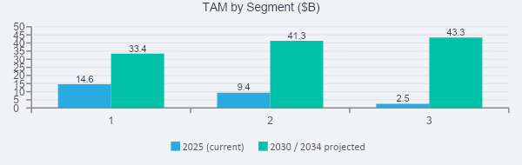
Total Addressable Market
Keean Kawai
SpaceX participates in four verified segments — combined $100B+ addressable market by 2030, growing toward $1T+ total space economy by 2032
SAT
Satellite Broadband
LCH
Commercial Launch
DEF
National Security
DTC
Direct-to-Cell
$33.4B by 2030
$41.3B by 2030
$5.9B NSSL ceiling
$43.3B by 2034
18.1% CAGR
14.6% CAGR
Contracted FY25–29
32.7% CAGR
SpaceX Position
SpaceX Position
SpaceX Position
SpaceX Position
Dominant LEO position
~65% of all active sats
>60% global share
~85% of US launches
97% of USSF task orders
Starshield ~$3.2B est. 2026
650+ DTC satellites live
T-Mobile, KDDI, Optus…
Was incorrectly shown as $1.6T — corrected to $14.6B (2025) → $33.4B (2030)
Corrected from $13.5B total pool → $5.9B is SpaceX-specific ceiling
Still pre-scale revenue in 2025–26; treat as embedded option within Starlink
Source: Grand View Research
MACRO BACKDROP
$613B
$1T+
Global space economy in 2024
+7.8% YoY · 78% commercial
Projected by 2032
(Space Foundation)
Sources: MarketsandMarkets · Grand View Research · Allied Market Research · Space Foundation Q2 2025 · US Space Force / Quilty Space · Morgan Stanley

Slide 5
Competitive Landscape
Nancy Zheng
Company
Category
Launch Share
Constellation
Revenue (est.)
Key Threat
SpaceX
Integrated Platform
~51% global
7,800+ sats
$15–16B
—
Amazon Kuiper
LEO Broadband
Minimal (own)
200+ sats (2026)
Parent $638B
Cloud + enterprise bundle
ULA
Gov't Launch
~20% NSSL
None
n.d.
Mission-assurance niches
Blue Origin
Heavy Lift
Nascent
None
n.d.
New Glenn heavy-lift optionality
Rocket Lab
Small Launch
~3%
Systems only
$602M
Emerging sub-scale challenger
Eutelsat / OneWeb
Sovereign LEO
Minimal
648 sats
~€1.6B
Government / sovereign channels
n.d. = not disclosed | No rival matches SpaceX on combined launch cadence + monetized LEO network
Notes:
Nancy

Slide 6
Strategic Moat Evaluation
Aarush Kothapalli
Overall Rating: WIDE — strongest where launch, satellites & network reinforce each other
Cost Leadership
Strong
Vertical Integration
Strong
Network Effects
Strong
Learning & Scale
Strong
Regulatory Resilience
Moderate
Governance
Weak
Primary discount factor: governance & regulatory resilience significantly lag economic moat strength
Notes:
Aarush

Slide 7
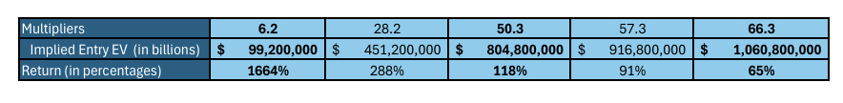
Financial Analysis
Van Jendian
$15–16B
$8B
~50%
$11.4B
63%
2025 Revenue (est.)
EBITDA (est.)
EBITDA Margin
Starlink Revenue
Starlink EBITDA Mg.
Scenario Valuation Summary
EV / Revenue Comparables
Notes:
Van

Slide 8
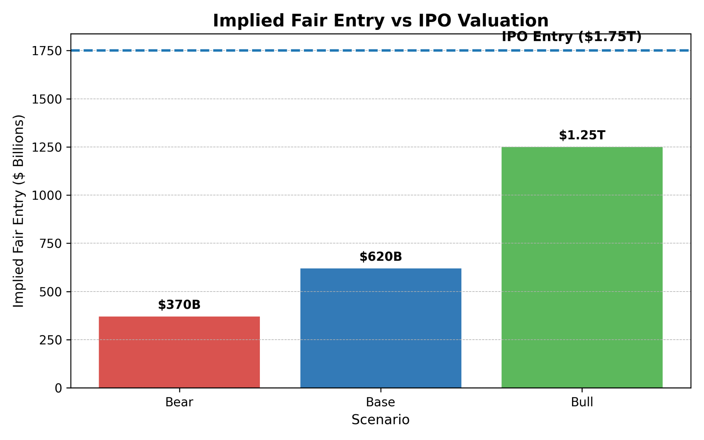
Valuation Methodology & VC Entry Analysis
Rishabh Gandhi
Valuation Framework
Starlink revenue = Subscribers × ARPU × 12
Launch = stable secondary revenue stream
Scenario-based EV/Revenue (25x - 60x) applied
Return Profile
Bear case: 0.32x → capital loss
Base case: 0.71x → subscale return
Bull case: 1.79x → below target return (2.0x)
Pricing vs Intrinsic Value
IPO valuation: $1.75T
Base-case value: $1.24T (–29%)
Bull-case fair entry: $1.25T (–28%)
Case | Exit Valuation | Target Return | Implied Fair Entry | Return @ $1.75T
Bear | $555B | 1.5x | $370B | 0.32x (loss)
Base | $1.24T | 2.0x | $620B | 0.71x (loss)
Bull | $3.13T | 2.5x | $1.25T | 1.79x (below target)
IPO entry of $1.75T exceeds all fair-entry thresholds — lower implied multiples produce higher investor returns
Notes:
Rishabh

Slide 9
Rachel Qiu
Risk Matrix
Likelihood × Impact — 16 risk factors mapped | TEAMMATE 5
Rare
Unlikely
Possible
Likely
Critical
R15
R8
R3
R1
High
R16
R14
R6
R2
Moderate
R13
R12
Low
R1 Musk key-person
R2 xAI cash burn
R3 Multiple compression
R6 Starship delays
R8 Space debris
Notes:
Rachel

Slide 10
Key Risk Deep Dive
Rachel Qiu
Risk
Mitigant
CRITICAL
R1 Musk Key-Person Risk
Mitigant: Businesses diversified across launch, broadband, and defense — less fragile than single-line contractor
Dual-class 10:1 Class B shares give unilateral control with no succession mechanism. Concurrently leads SpaceX, xAI, Tesla, and DOGE.
CRITICAL
R3 Valuation / Multiple Compression
$1.75T implies ~109× P/S on $16B 2025 revenue. No public market comparable. Bear and base-case exits return <1.0× on IPO entry.
Mitigant: Bear case still >$550B — catastrophic total-loss scenario is not the base risk, compression is
HIGH
R2 xAI Cash Burn Import
Post-merger, xAI's $9.5B burn (3Q 2025) on $210M revenue creates structural cross-subsidy absorbed by IPO investors.
Mitigant: Starlink EBITDA ($8B+) provides buffer, but investor dilution from continued xAI losses is real
HIGH
R8 Space Debris & Collision Risk
7,800+ satellites in orbit; fleet density growth raises Kessler cascade probability and regulatory scrutiny over the investment horizon.
Mitigant: SpaceX maintains best-in-class deorbit compliance record; operational leadership is a regulatory asset
Notes:
Rachel

Slide 11
HOLD /
PASS
Rishabh Gandhi
The business is exceptional. The price is not.
Investment View
Strong Business
Wide moat: launch + Starlink integration
Dominant LEO broadband position
Large and expanding TAM
Key Risks
Governance concentration (Musk control)
xAI capital allocation / dilution risk
Multiple compression at scale
Valuation Disconnect
IPO: $1.75T
Base value: $1.24T (–29%)
Returns: <1.0x in bear/base scenarios
AT $1.75T IPO PRICING
Conditions to upgrade to BUY
1
Secondary / pre-IPO access at ≤$1.25T (bull fair entry)
2
Post-lockup re-rating to ≤$1.0–1.2T
3
xAI losses capped / structurally ring-fenced from SpaceX
4
Governance improvement: independent board, succession plan disclosed
Overall moat: WIDE · Economic moat: strong · Governance moat: weak · Entry price: unattractive
Notes:
Rishabh

Slide 12
$15M Investment Structure Proposal
Nancy Zheng
Tranche the position — do not deploy $15M at IPO
Structure
1
Deploy $5–7M at IPO open. Reserve $8–10M for 90–180 day post-lockup window where early-investor selling historically compresses multiples toward base case.
Pursue secondary / pre-IPO access immediately ★ Preferred
Priority
2
VC fair entry at bull-case is $1.25T. Pre-IPO secondary at $800B–$1.0T is structurally superior. Engage Forge Global, Nasdaq Private Market now.
Set governance trigger for IC review
Risk Mgmt
3
Auto-convene IC within 30 days if: Musk divests >5% personal holdings / xAI losses exceed $15B/yr / second Starship regulatory pause occurs.
Hard cap at 10% of alternatives book
Limit
4
$15M = 10.4% of $144M alt allocation. Do not average up above $1.75T under any scenario. Ceiling holds unless re-rating brings entry below $1.2T.
Hedge via public-market satellite basket
Hedge
5
Small position in Iridium / Viasat / Rocket Lab as partial hedge. If SpaceX thesis re-rates negatively, competitive dynamics lift these names.
Notes:
Nancy

